Slide 1
Filter UX

Slide 2
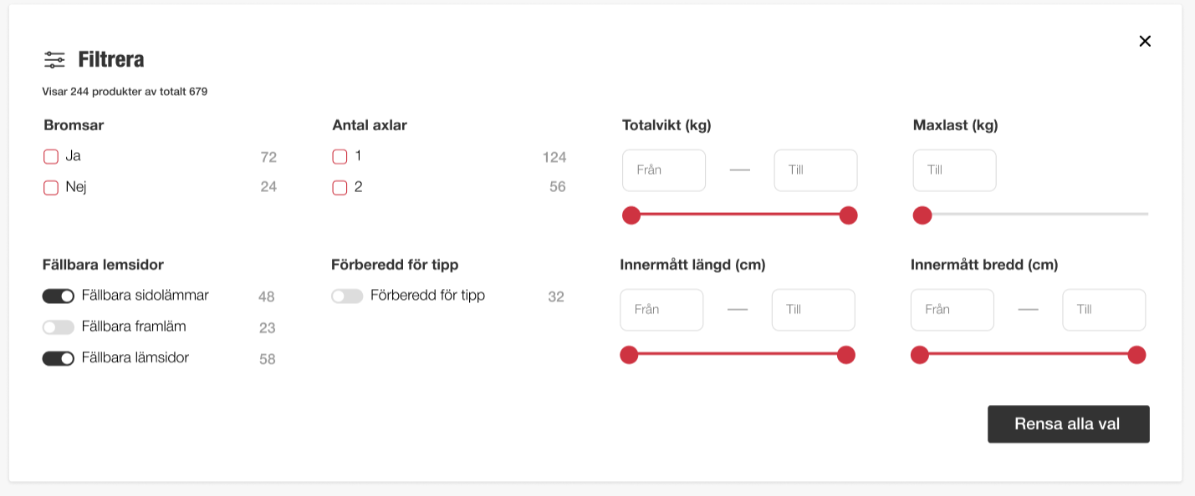
”List” setting
Sorted Accending setting
The filter Block/Component
May have certain settings
The Website theme should have default color settings for the filter ”form”
”Slider Min-Max” setting
”Slider up to Max” setting
Bolean setting

Slide 3
Solution proposal

Slide 4
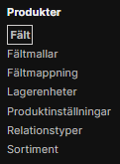
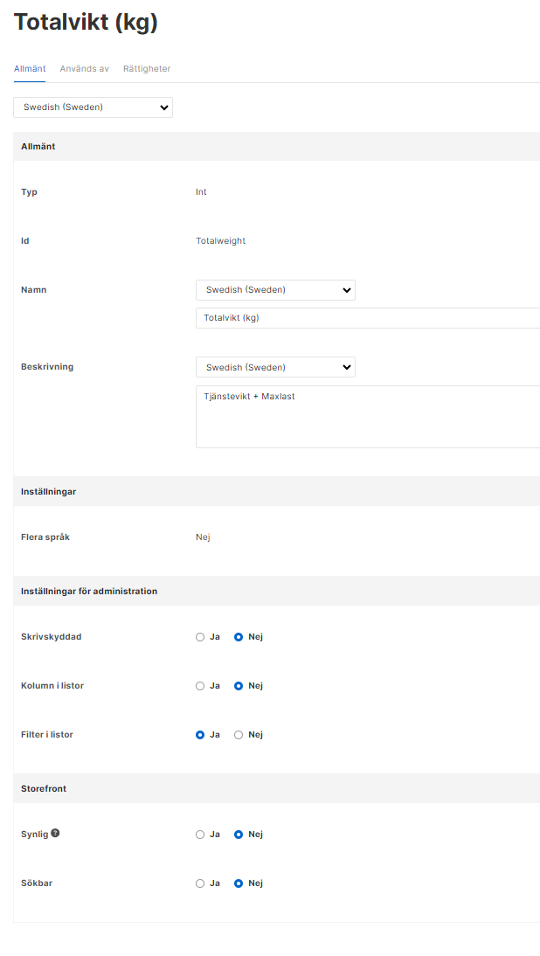
Configuring filter UX
Add a new UX Filter type
UX Filter settings
Storefront defaults
(possible to define client unique in above UX Filter Types)
Filter type
Select filter type
List (single value selection)
List (multi value selection)
Dropdown (single value selection)
Dropdown (multi value selection)
Slider Min-Max
Slider up to Max
Slider down to Min
Bolean
Sorting
Sorting
O None
O Ascending
O Descending
Stickyness
The slider only stick to actual values
Slider stickyness
O Floating
O Fixed value steps
Default value
340
Default
For bolean it can be Yes or No as default, comma separated for other types, multi language if field is multi language

